Slide 1
Introduction
Overall 9 + Years Industry Experience
Senior Solution Architect (Azure Solution Architect)
Machine Learning Engineer
Senior Software Developer → Full Stack .NET Developer
Domain Expertise ->
Banking, E-Commerce. HealthCare, Aviation
Presented By : Abhishek Panda

Slide 2
Azure Learning Path
3d datacenter virtual tour :
https://news.microsoft.com/stories/microsoft-datacenter-tour/lobby/
Azure pricing calculator :
https://azure.microsoft.com/en-us/pricing/calculator/
Az-104 Exam Details :
https://docs.microsoft.com/en-us/learn/certifications/exams/az-104
Created By : Abhishek Panda

Slide 3
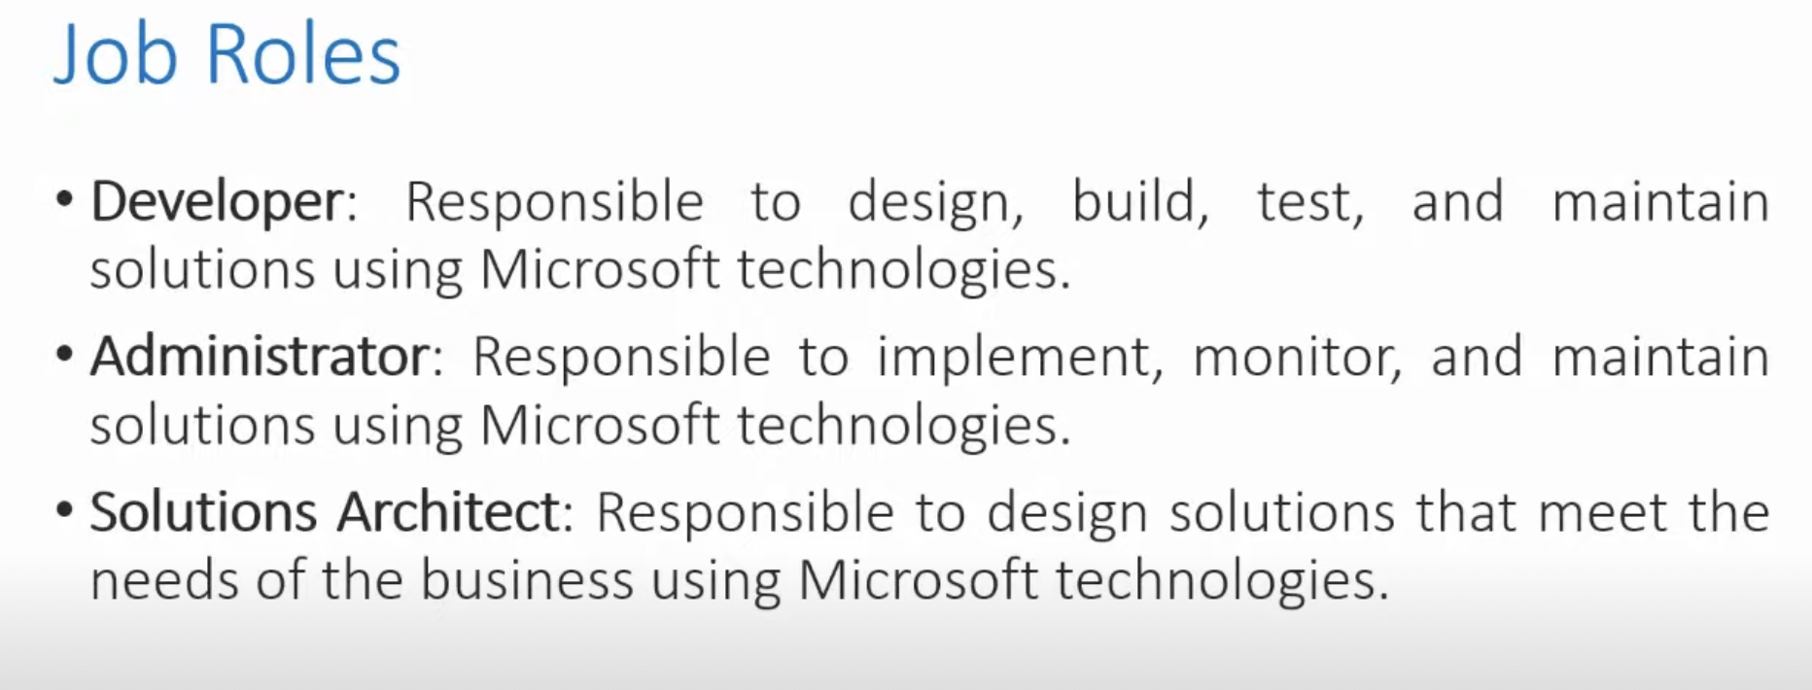
Job Roles and Certification
Created By : Abhishek Panda

Slide 4
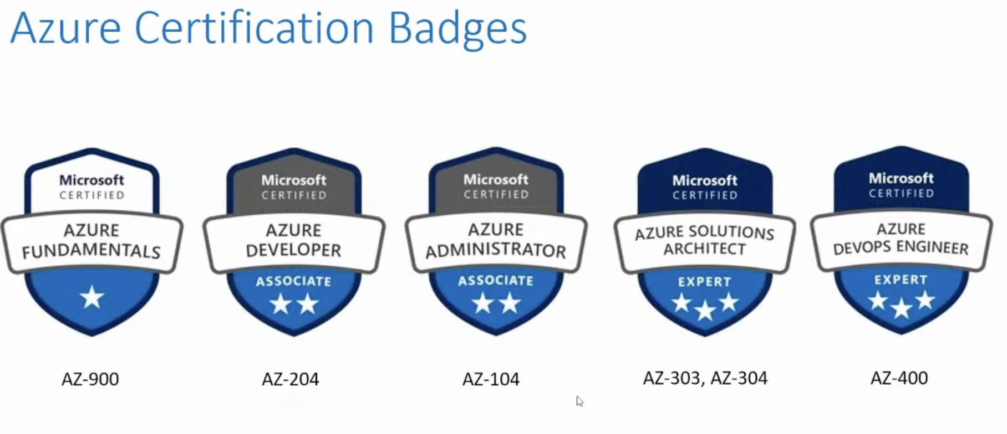
Job Roles and Certification
Created By : Abhishek Panda

Slide 5
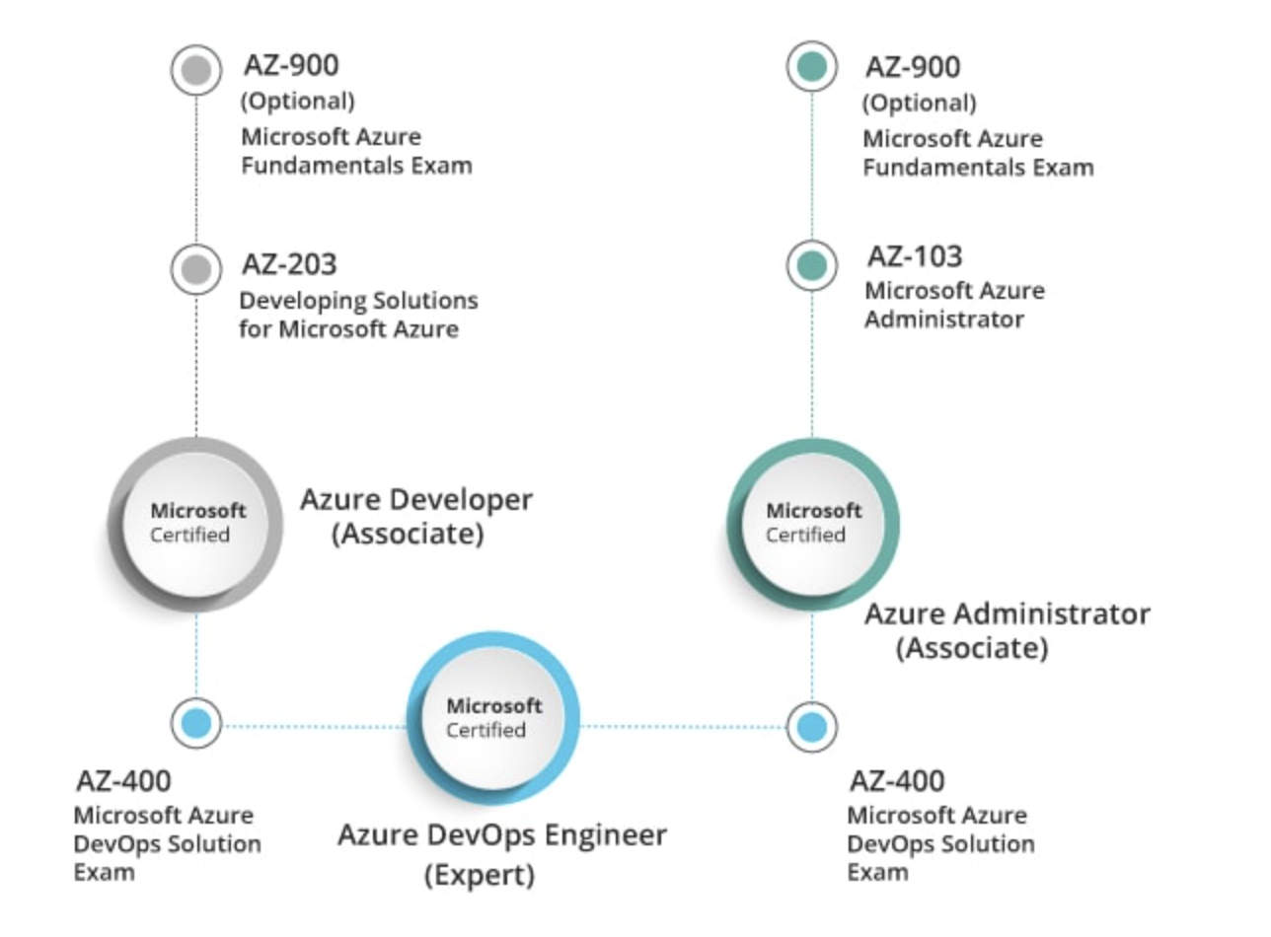
Role Based Certification
Created By : Abhishek Panda

Slide 6
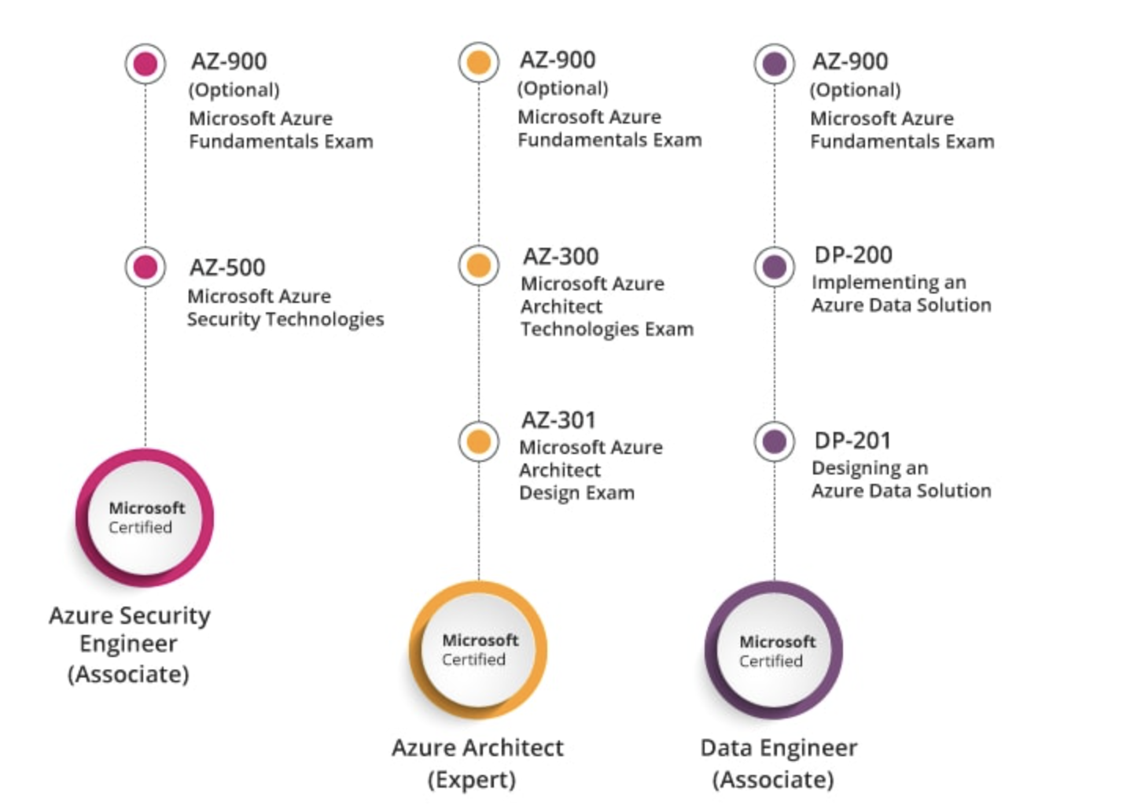
Role Based Certification
Created By : Abhishek Panda

Slide 7
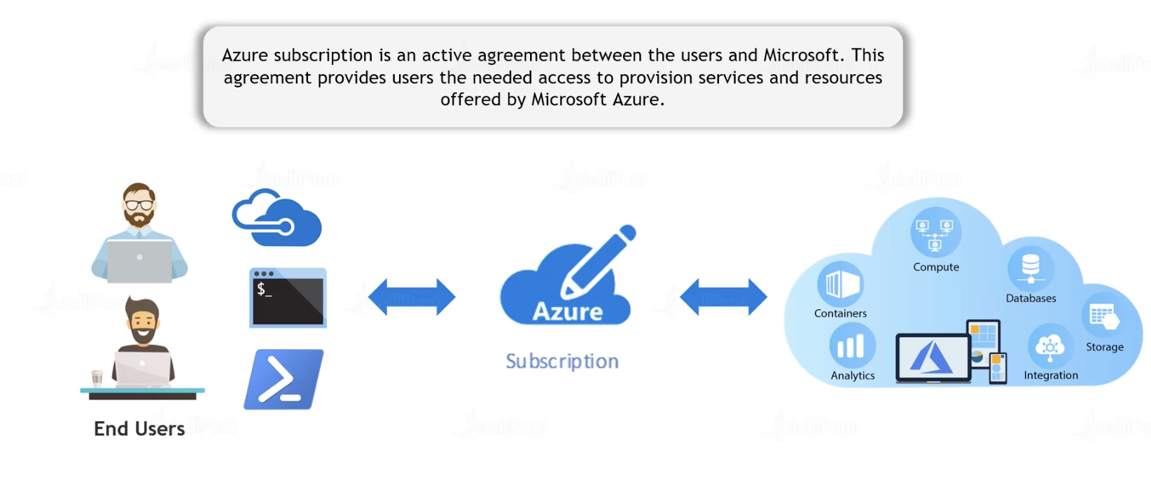
Azure Subscription
Created By : Abhishek Panda

Slide 8
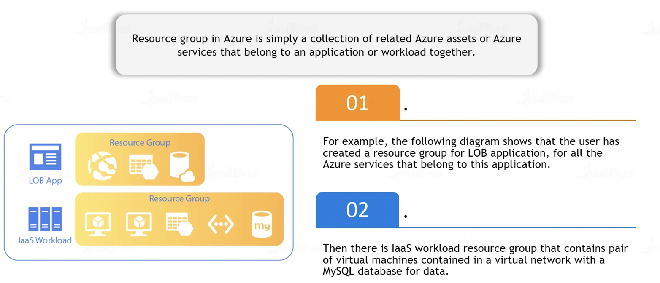
Resource Group
Created By : Abhishek Panda

Slide 9
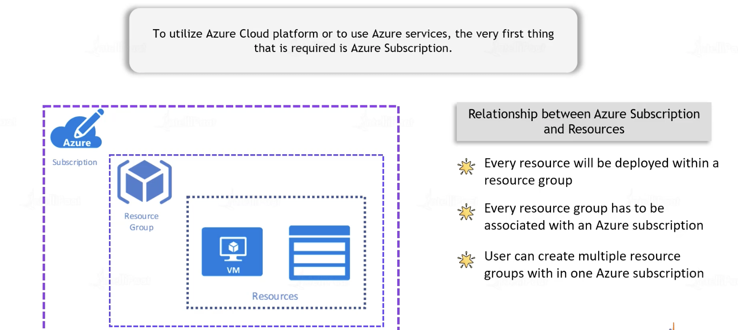
Azure Subscription & Resources
Created By : Abhishek Panda

Slide 10
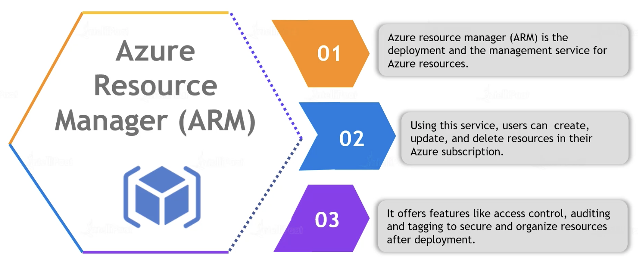
ARM(Azure Resource Manager)
Created By : Abhishek Panda

Slide 11
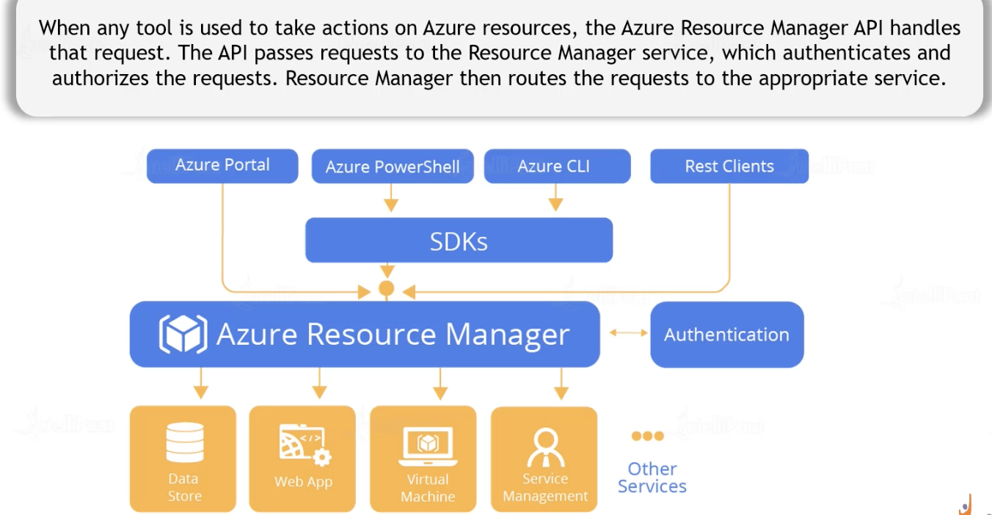
ARM(Azure Resource Manager)
Created By : Abhishek Panda

